Slide 1




AI-Powered RAG Chatbot
Muhammed Midlaj P | 23BBCAMR303
Department of Computer Science & Information Technology
Internship Company: Scanntek IT Solutions LLP
Internal Guide: Dr. Kaviyarasi
External Guide: Neha
Muhammed Midlaj P
1

Slide 2
AGENDA
1. Introduction
2. Organization Profile
3. Learning Modules
4. Project Implemented
5. Problem Statement
6. Objectives
7. Scope of the Project
8. Technologies Used
9. System Architecture
10. Methodology
11. Implementation
12. Progress / Status
13. Conclusion
Muhammed Midlaj P
2

Slide 3
Introduction
• Internship focused on building an enterprise-grade AI-Powered
Retrieval-Augmented Generation (RAG) Chatbot system.
• Purpose: Enable organizations to query their own documents
using natural language and receive AI-powered answers with
source citations.
• Domain: Artificial Intelligence / Natural Language Processing,
specifically RAG-based conversational AI for enterprise data.
• Combines modern full-stack web development with cutting-edge
AI/ML techniques including agentic reasoning, vector search,
and multimodal document understanding.
Muhammed Midlaj P
3

Slide 4
Organization profile
• Company Name: Scanntek IT Solutions LLP
• Location: Kinfra IT Park, Calicut, Kerala
• Industry Domain: Digital Marketing, Web Development & IT Services
• Company Type: Product & Service Based (LLP, Inc. Nov 2022)
• Description: Scanntek IT Solutions LLP is an active, Kerala-based
Limited Liability Partnership focusing on digital marketing,
branding, web development, and IT services.
• Role: Full-Stack AI Developer — Designed and developed the
end-to-end RAG Chatbot platform including backend API,
frontend UI, AI pipeline, and DevOps infrastructure.
Muhammed Midlaj P
4

Slide 5
LEARNING MODULES
Concepts Learnt:
• Retrieval-Augmented Generation (RAG) Architecture
• Vector Embeddings & Semantic Search (3072-dim vectors)
• Agentic AI — ReAct Loop (Think → Action → Observe)
• LLM Prompt Engineering & Chain-of-Thought Reasoning
• Multimodal AI — Vision & Document Understanding
• Full-Stack Development with Django & React
Tools Utilized:
• LangChain, Qdrant, Google Gemini, Docker, PostgreSQL, Redis
• Git/GitHub, VS Code, Postman, Swagger UI
Period of Study: 10 Weeks (February – April 2026)
Muhammed Midlaj P
5

Slide 6
PROJECT(S) IMPLEMENTED
Title: AI-Powered RAG Chatbot
An enterprise-grade Retrieval-Augmented Generation chatbot
for company database analysis, built with Django REST
Framework and React.
Key Capabilities:
• RAG Chat with SSE-streamed responses & source citations
• Multimodal support (images, PDFs, DOCX, CSV, Markdown)
• Agentic semantic search with ReAct reasoning loop
• Document collections, tags, and scoped querying
• Admin dashboard with usage analytics & metrics
• JWT authentication, rate limiting, CSP/HSTS security
• Dockerized microservices with CI/CD pipelines
Muhammed Midlaj P
6

Slide 7
Problem Statement(s)
What problem is being solved?
• Organizations struggle to extract insights from large volumes
of unstructured documents (PDFs, reports, spreadsheets).
• Traditional keyword search fails to understand context and
semantic meaning, returning irrelevant results.
• Employees waste hours manually searching through documents.
Why is it important?
• Enterprises need instant, accurate, AI-powered answers
grounded in their own data — not generic LLM hallucinations.
• RAG ensures responses are factual, cited, and traceable to
source documents, enabling trust and compliance.
Muhammed Midlaj P
7

Slide 8
Objectives
General Objectives:
• Build an AI chatbot that retrieves and reasons over documents
• Provide accurate, citation-backed answers via RAG architecture
Specific Objectives:
• Implement multi-format document ingestion (PDF, DOCX, CSV, images)
• Build 3072-dim vector search with Qdrant + Gemini Embeddings
• Develop an agentic ReAct loop for intelligent query processing
• Create a real-time SSE chat interface with React 19
• Build an admin dashboard for usage analytics & user management
• Implement enterprise security: JWT, rate limiting, CSP headers
• Containerize the full stack with Docker Compose
Muhammed Midlaj P
8

Slide 9
Scope of the Project
What the project covers:
• Full-stack web application (Django + React)
• AI/ML pipeline: ingestion → embedding → retrieval → generation
• Multimodal RAG: text documents + image understanding
• Role-based access control (Admin, Editor, Viewer)
• CI/CD pipelines with GitHub Actions
• Dockerized microservices architecture
Limitations:
• Depends on Google Gemini API (cloud-based, requires API key)
• Not designed for real-time collaborative document editing
• Maximum context window constrained by LLM token limits
Muhammed Midlaj P
9

Slide 10
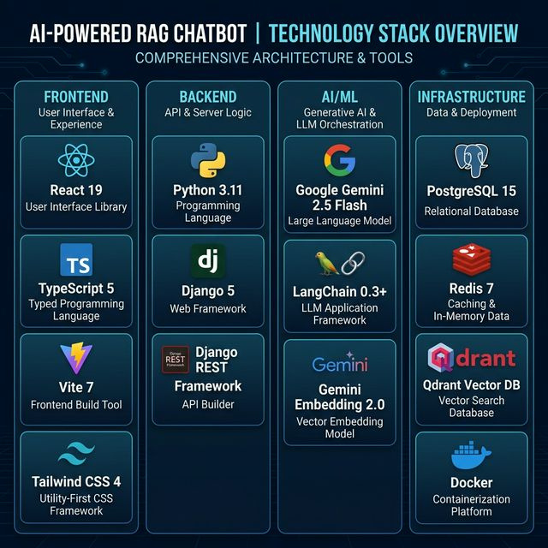
Technologies Used
Languages:
• Python 3.11, TypeScript 5, SQL
Frameworks:
• Django 5, DRF, React 19, Vite 7
• Tailwind CSS 4
AI/ML:
• Google Gemini 2.5 Flash
• Gemini Embedding 2.0
• LangChain 0.3+
Infrastructure:
• PostgreSQL 15, Qdrant, Redis 7
• Docker, GitHub Actions CI/CD
Muhammed Midlaj P
10

Slide 11
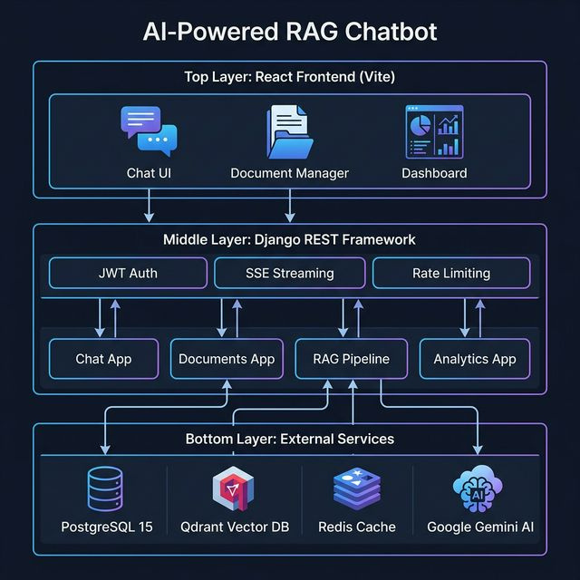
System Architecture
Layered microservices architecture:
• Frontend → Backend API →
App Modules → Storage Layer
• RAG Pipeline: Ingest → Embed →
Store → Retrieve → Generate
Muhammed Midlaj P
11

Slide 12
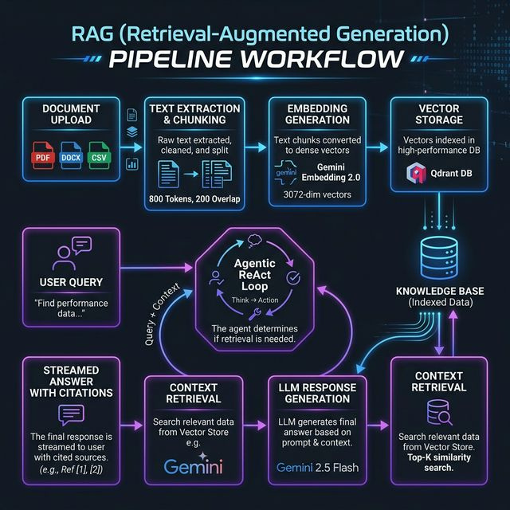
Methodology
Development Process:
Agile (5 Sprints × 2 Weeks)
Sprint 1 — Requirements, setup,
DB schema design
Sprint 2 — RAG pipeline (ingest,
embed, vector storage)
Sprint 3 — Agentic reasoning,
multimodal support
Sprint 4 — Dashboard, analytics,
auth & security
Sprint 5 — Docker, CI/CD, testing,
optimization
Muhammed Midlaj P
12

Slide 13
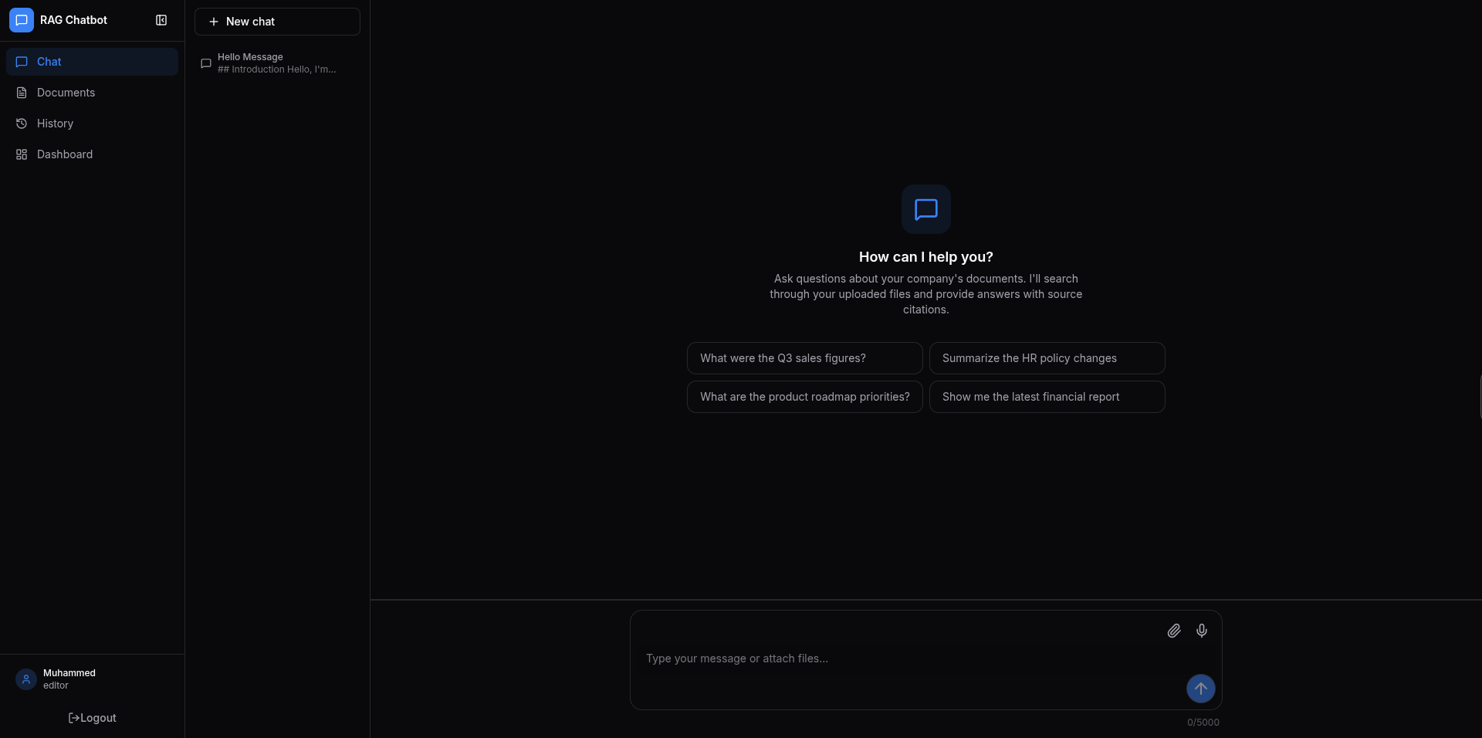
Implementation
Key Modules Implemented:
1. Document Management
Upload PDF, DOCX, CSV, images
with auto-chunking
2. RAG Pipeline
LangChain + Qdrant + Gemini
3. Agentic Search
ReAct: Think → Action → Observe
4. Multimodal AI
Gemini Vision for images/charts
5. Real-time Chat (SSE streaming)
6. Admin Dashboard & Analytics
7. JWT Auth & Security Layer
8. Docker & CI/CD Pipeline
Muhammed Midlaj P
13

Slide 14
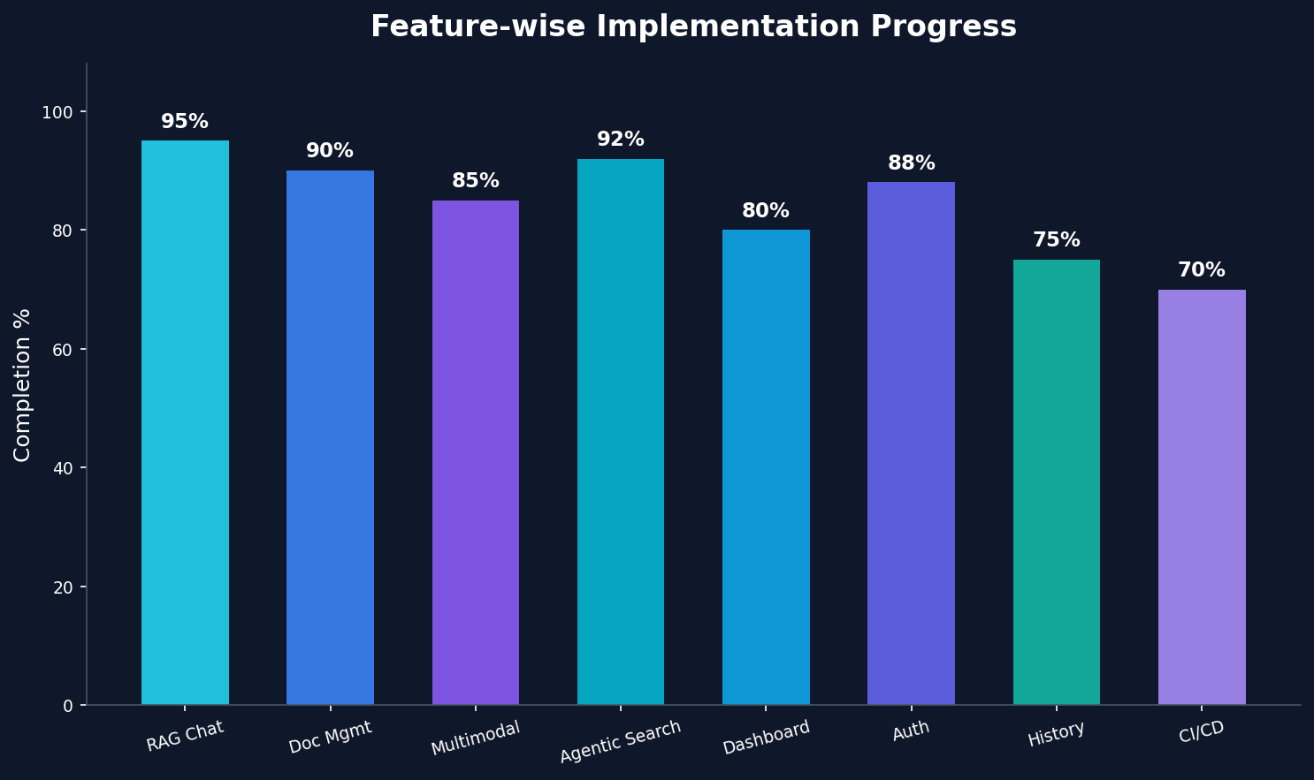
PROGRESS STATUS
Completion: 75%
Milestones Achieved:
✅ Full RAG pipeline with
agentic reasoning
✅ Multimodal document &
image processing
✅ Complete frontend (Dashboard,
Chat, Documents, History)
✅ JWT auth & role-based access
✅ Docker & CI/CD pipelines
Future Work:
• Performance optimization
• Advanced analytics
• Cloud deployment
Muhammed Midlaj P
14

Slide 15
Conclusion
Summary:
• Successfully designed and developed an enterprise-grade
AI-Powered RAG Chatbot enabling natural language querying
of company documents with cited, accurate responses.
• Implemented cutting-edge techniques: agentic ReAct reasoning,
3072-dimensional vector search, multimodal AI, and SSE streaming.
• Built a production-ready, containerized full-stack application
with React frontend, Django backend, and intelligent RAG pipeline
powered by Google Gemini.
Final Outcome:
• The system demonstrates significant improvement in document
retrieval accuracy over traditional keyword search methods,
making enterprise knowledge instantly accessible through
natural conversation.
Muhammed Midlaj P
15

Slide 16
Implementations
Key Implementation Highlights:
1. RAG Pipeline (rag_chain.py)
• Agentic ReAct loop — max 3 iterations
• SSE token-by-token streaming to UI
• LLM retry on 429 with exponential backoff
2. Vector Store (vector_store.py)
• Qdrant with 3072-dim Gemini embeddings
• Hybrid semantic + metadata-scoped search
3. Document Ingestion
• PDF / DOCX / CSV / Image auto-chunking
• Gemini Vision for charts & images
4. Real-Time Chat (SSE Streaming)
• Thought / Answer stream split to frontend
• JWT auth + role-based session isolation
Muhammed Midlaj P
13

Slide 17
Test Cases
TC-ID | Test Case Description | Test Steps (Summary) | Expected Result | Status
TC-01 | Document Upload | Upload a PDF via /api/documents/ | File chunked & vectors stored in Qdrant | ✅ PASS
TC-02 | RAG Query Response | Send query 'What is our leave policy?' | Cited answer returned with source references | ✅ PASS
TC-03 | Agentic Search Loop | Submit complex multi-step question | Answer produced in ≤ 3 ReAct iterations | ✅ PASS
TC-04 | JWT Authentication | Call API with an expired/invalid token | 401 Unauthorized returned immediately | ✅ PASS
TC-05 | SSE Streaming | Open chat and send a message | Tokens streamed in real-time to browser | ✅ PASS
TC-06 | Rate Limit Retry | Simulate 429 from Gemini API | Exponential backoff + auto-retry succeeds | ✅ PASS
TC-07 | Multimodal Image Upload | Upload a PNG chart image | Gemini Vision extracts & indexes content | ✅ PASS
TC-08 | Collection Scoping | Query within a specific document collection | Results limited to that collection only | ✅ PASS
Muhammed Midlaj P
14

